Slide 1





Console Tic-Tac-Toe
CSE 115 Term Project | Group 02
Lead Dev
Board & Display
Player Input
Soumik Halder (2531413042)
Mostafia Al Jannati (2532532642)
Shreyosi Mohanta (2532176042)
Game Logic
Docs
Md. Kaif Khan (2532389642)
Sarah Tabassum (2531479042)
Group 02 | Soumik Halder, Mostafia Al Jannati, Shreyosi Mohanta, Md. Kaif Khan, Sarah Tabassum

Slide 2
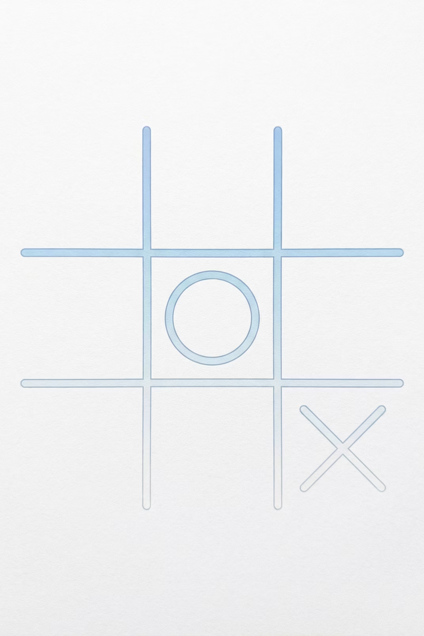

The Objective
Our mission was to engineer a robust, console-based multiplayer Tic-Tac-Toe game engine using the C programming language. We focused on creating a seamless and engaging user experience while adhering to best practices in software development.
Stability
Zero crashes via robust input handling and comprehensive error management.
Modularity
Clean separation of concerns, ensuring distinct logic for game rules and user interface.
Seamless Experience
An intuitive user loop with integrated Instant Replay capabilities for enhanced engagement.
Group 02 | Soumik Halder, Mostafia Al Jannati, Shreyosi Mohanta, Md. Kaif Khan, Sarah Tabassum

Slide 3
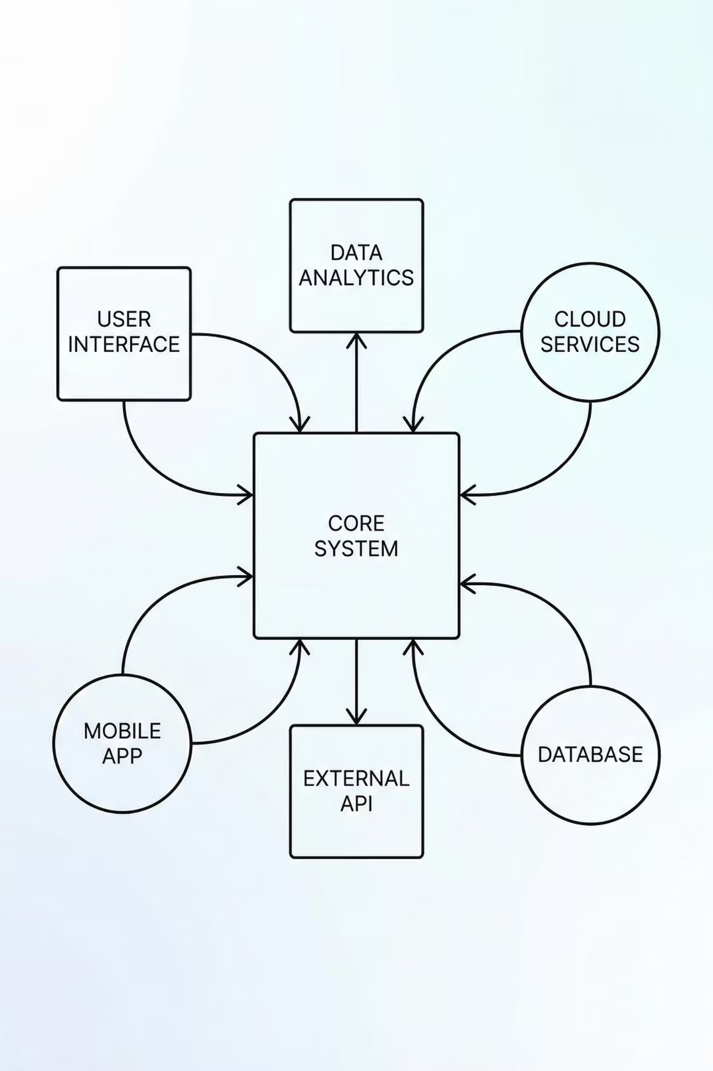

Modular Design Strategy
To ensure maintainability and prevent "spaghetti code," we rigorously split the project into distinct, logical modules. This approach promotes clear responsibilities and simplifies future enhancements.
1
main.c
The application's entry point and primary game loop controller.
2
board.c
Responsible for rendering and managing the 3x3 grid interface.
3
input.c
Dedicated to sanitizing user data and processing player commands.
4
game_logic.c
Encapsulates the core rule engine and win/draw detection algorithms.
Group 02 | Soumik Halder, Mostafia Al Jannati, Shreyosi Mohanta, Md. Kaif Khan, Sarah Tabassum

Slide 4
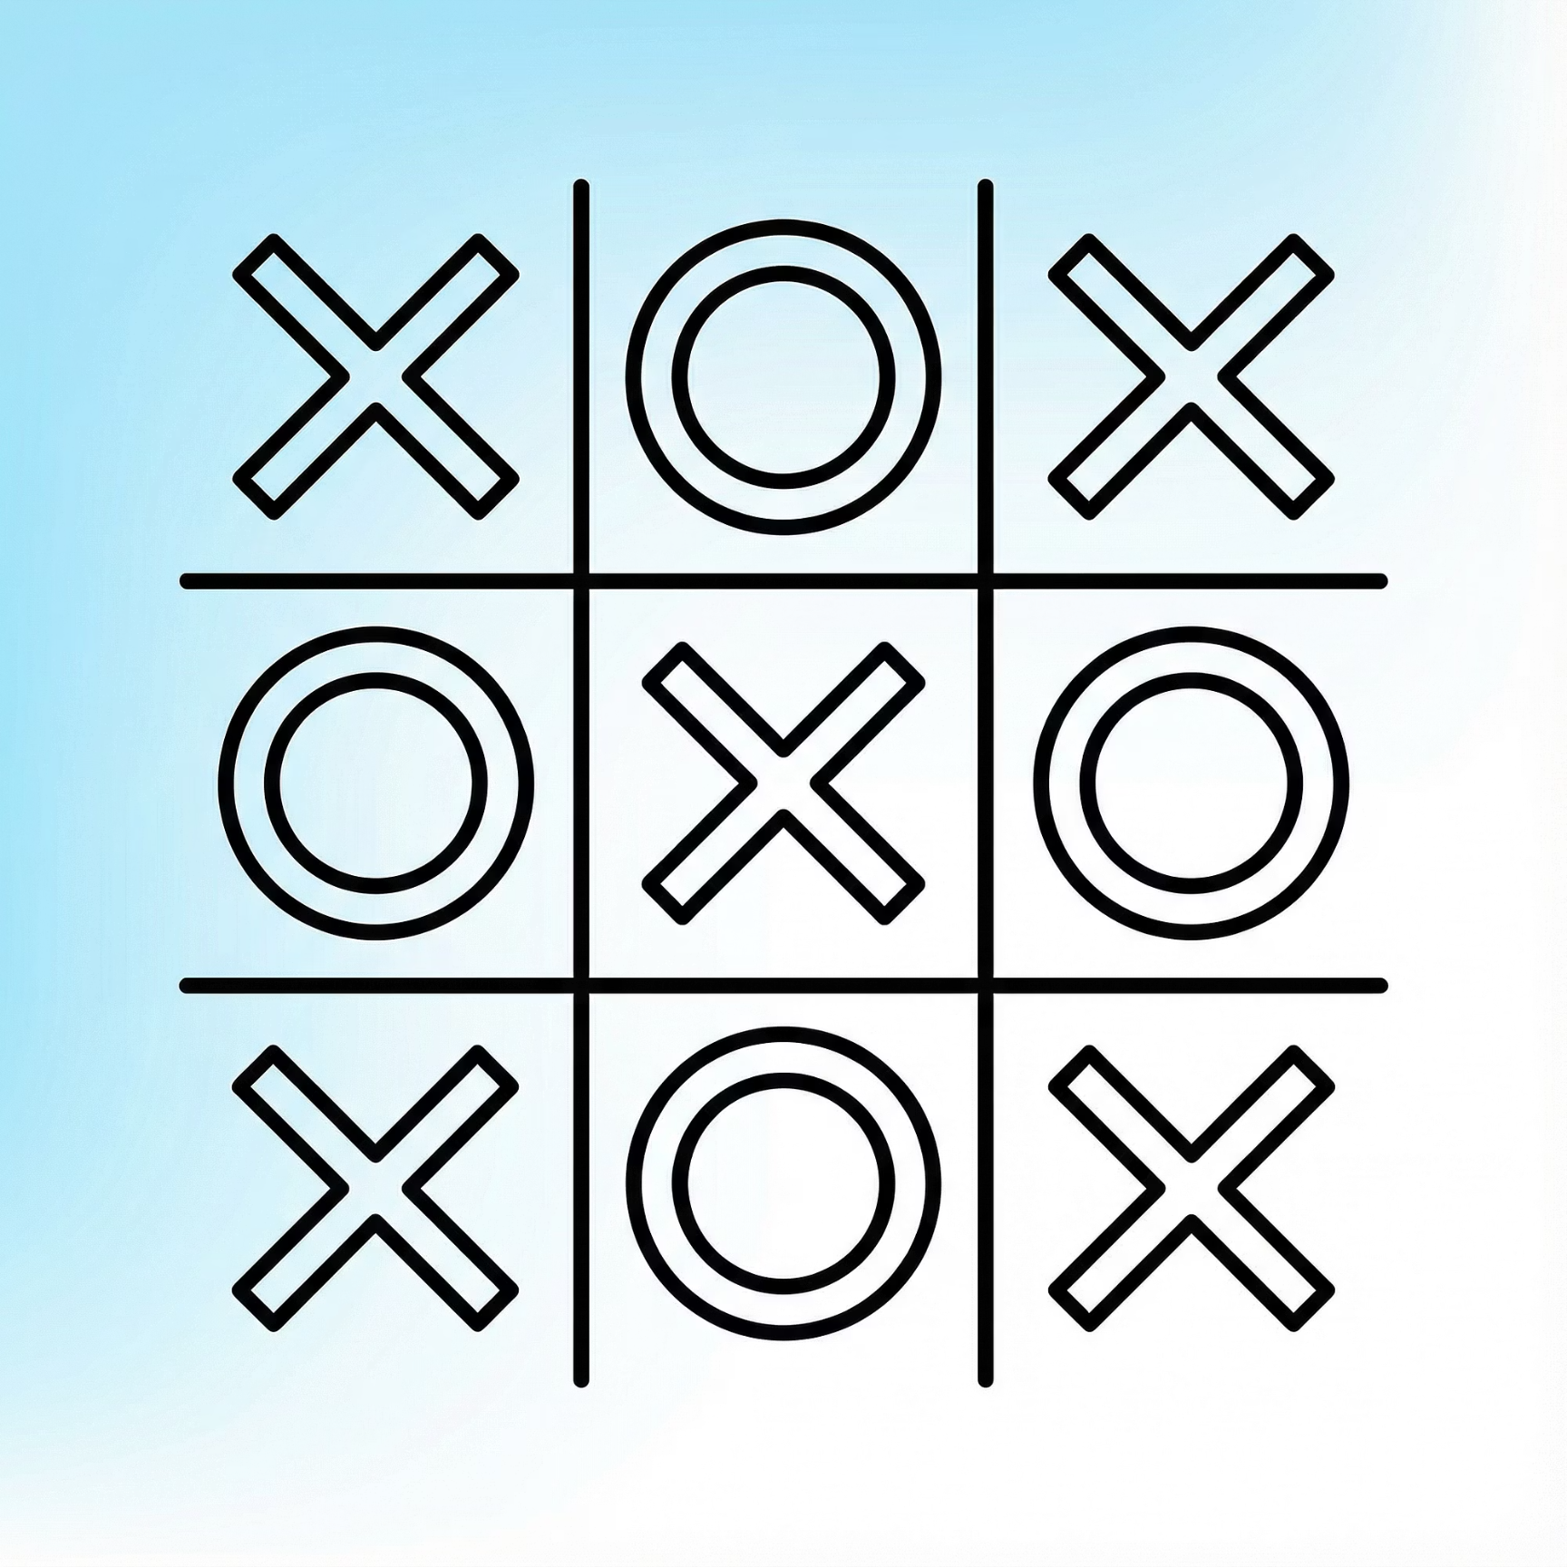
Visualizing the Grid
The Board & Display Module is crucial for player interaction. It dynamically renders the game state, ensuring players always see an up-to-date and intuitive representation of the board.
Core Logic
Utilizes a 3x3 2D Character Array (char board[3][3]) to store game state.
The printBoard() function redraws the grid after every move, updating cell states (X, O, or Empty).
Empty cells display numbers (1-9) for clear user guidance during selection.
Group 02 | Soumik Halder, Mostafia Al Jannati, Shreyosi Mohanta, Md. Kaif Khan, Sarah Tabassum

Slide 5

UX & Error Prevention
Player Input Module
A common challenge in C console applications is handling invalid user input without crashing. Our Input Module provides a robust solution, enhancing both user experience and program stability.
The Problem
Standard scanf() functions often lead to program crashes when a user mistakenly types text into an integer input field.
Our Solution
The getUserInput() function prioritizes safety. It reads all data as a string first, then carefully parses commands:
'r' = Restart Game (Return code -2)
'e' = Exit Game (Return code -1)
'1-9' = Valid Move (Converted via atoi())
Group 02 | Soumik Halder, Mostafia Al Jannati, Shreyosi Mohanta, Md. Kaif Khan, Sarah Tabassum

Slide 6
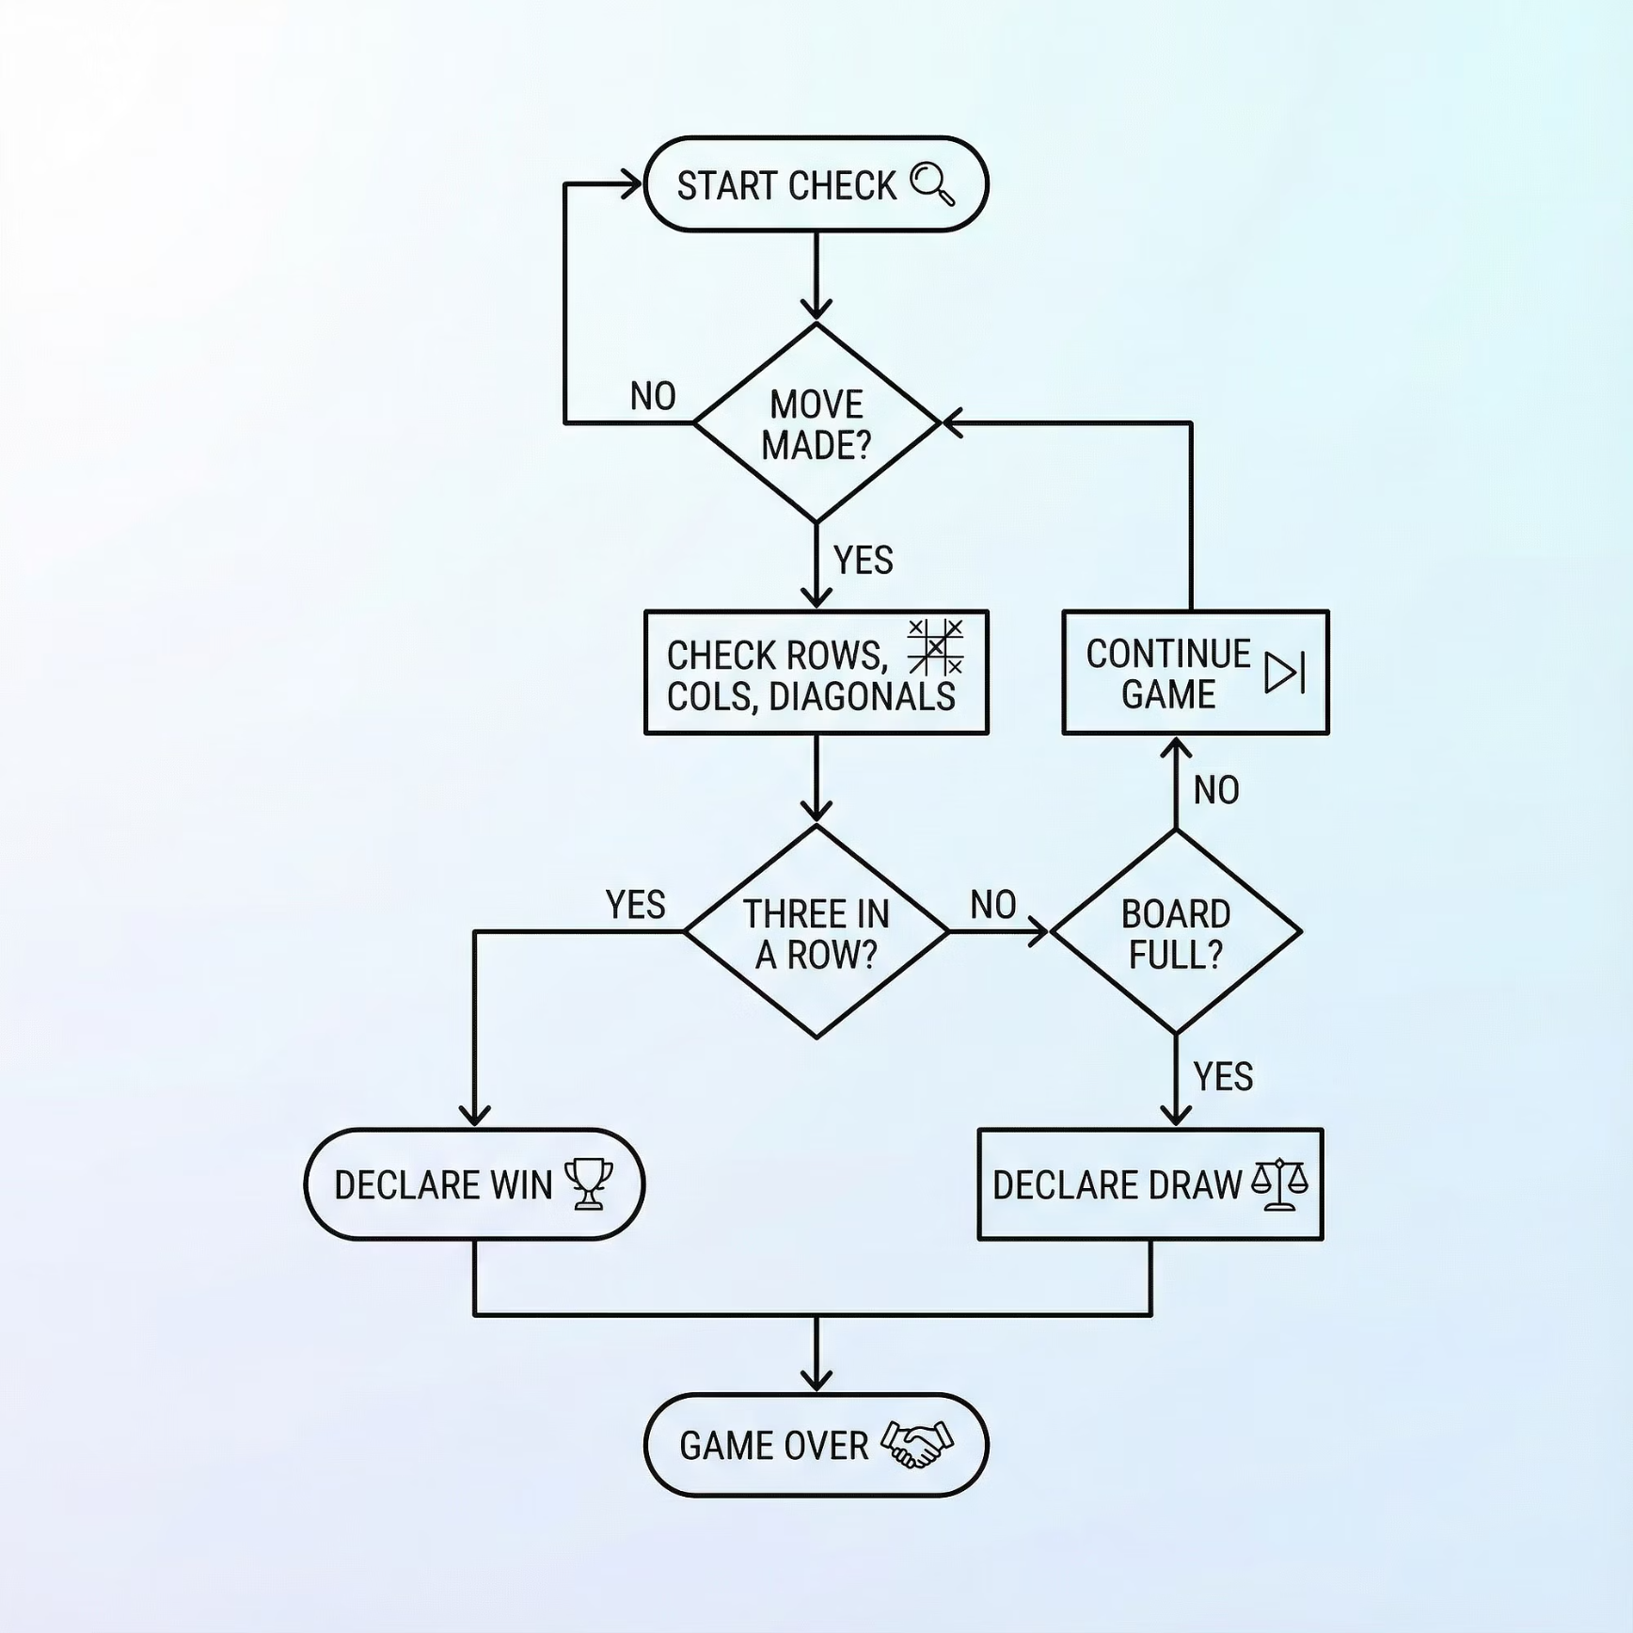
The Win Algorithm
Game Logic Module
The heart of our game is the Game Logic Module, which continuously evaluates the board state to determine wins or draws, ensuring fair play and accurate game progression.
Continuous Evaluation: The checkWinner() function runs after every move, ensuring immediate detection of game-ending conditions.
Row & Column Scans: Systematically checks board[i][0] == board[i][1] == board[i][2] for all rows and columns.
Diagonal Checks: Verifies win conditions across both main diagonals using hardcoded index patterns (e.g., board[0][0] to board[2][2]).
Draw Detection: The isBoardFull() function determines if all cells are occupied without a winner, leading to a draw.
Group 02 | Soumik Halder, Mostafia Al Jannati, Shreyosi Mohanta, Md. Kaif Khan, Sarah Tabassum

Slide 7

Execution Flow
Our game operates on a robust and continuous loop, designed to provide a smooth and uninterrupted playing experience, allowing for multiple rounds without restarting the program.
Initialize
Print Board
Player Input
Update & Check
The core while (!exitProgram) loop ensures continuous play, a key requirement for a smooth and engaging user experience.
Group 02 | Soumik Halder, Mostafia Al Jannati, Shreyosi Mohanta, Md. Kaif Khan, Sarah Tabassum

Slide 8

Version Control & Teamwork
Our project leveraged GitHub for collaborative development, ensuring seamless version control, transparent contribution tracking, and efficient code integration among team members.
Centralized Repository: Project hosted on GitHub with a clear and professional README.md.
Transparent History: Detailed commit logs reflect active contributions and development from all team members.
Structured Workflow: Code was consistently pushed, thoroughly reviewed, and merged to maintain integrity and prevent conflicts.
https://github.com/gh0st-spritx/cse115-tictactoe
Group 02 | Soumik Halder, Mostafia Al Jannati, Shreyosi Mohanta, Md. Kaif Khan, Sarah Tabassum

Slide 9
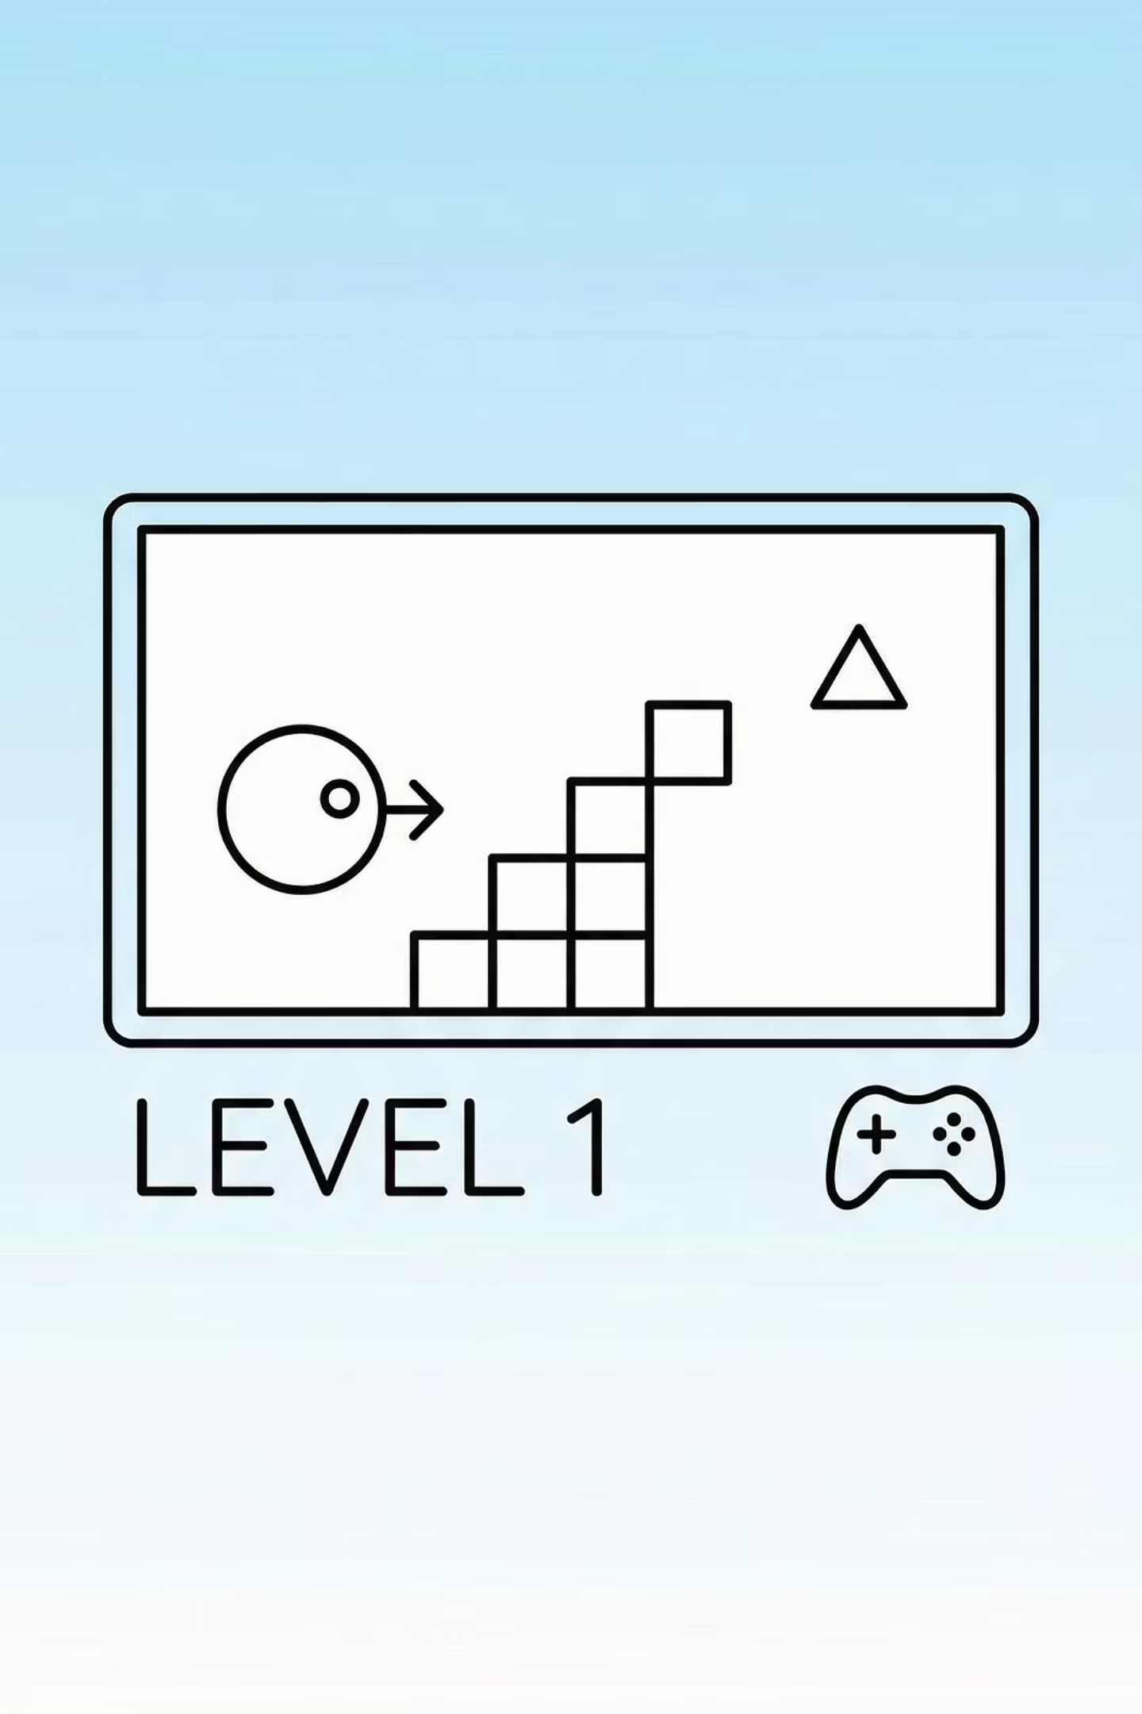

Live Demonstration
We are prepared to showcase our Console-Based Tic-Tac-Toe project, highlighting both the underlying code architecture and the game's functional mechanics.
Code Walkthrough
A deep dive into the source files on GitHub, explaining key functions and modular design principles.
Video Demo
A concise 1-minute screen capture showcasing gameplay, edge-case handling, and win/draw states.
Group 02 | Soumik Halder, Mostafia Al Jannati, Shreyosi Mohanta, Md. Kaif Khan, Sarah Tabassum

Slide 10
Summary & Future Scope
This project effectively demonstrates our mastery of fundamental C concepts, modular design, and robust programming practices.
Core Takeaway
Proficient application of C arrays, pointers, string manipulation, and a well-structured modular architecture.
Single Player AI
GUI Implementation
Persistent Scoreboard
Implement a challenging AI opponent using algorithms like Minimax.
Transition to a graphical user interface for enhanced visual appeal and interaction.
Utilize File I/O to save and display game records and player statistics.
Questions?
Group 02 | Soumik Halder, Mostafia Al Jannati, Shreyosi Mohanta, Md. Kaif Khan, Sarah Tabassum

